Slide 1
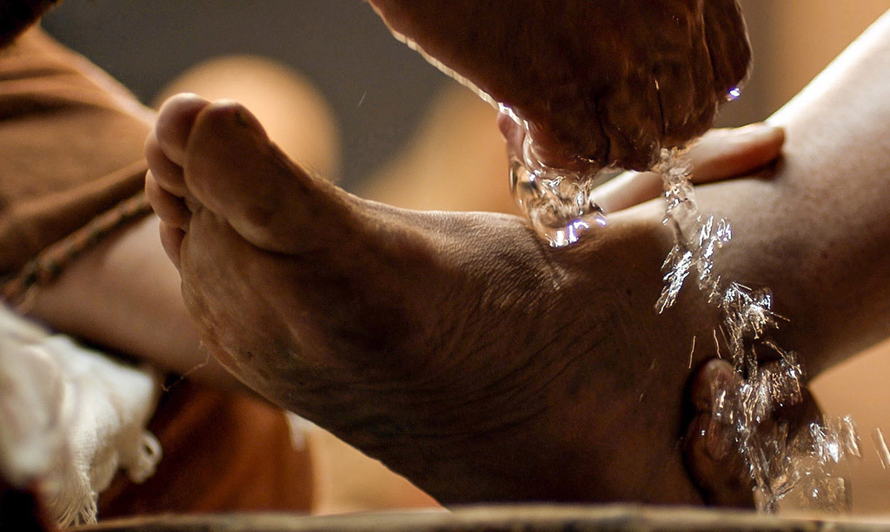
Developing True Humility
-Jesus’ path of servanthood-
John 13:1-17
Preached by Dr. Jim Harmeling at Crossroads International Church Singapore • CICFamily.com Uploaded by Dr. Rick Griffith • Jordan Evangelical Theological Seminary Files in many languages for free download at BibleStudyDownloads.org

Slide 2
Develop humility by accepting divine authority (vs. 1-3)
Authority over circumstances: Jesus knows his hour is at hand (1a)
Authority over mankind: Jesus loves his own to the end (1b)
Authority over the devil: Jesus knows the devil has devised his plan (2)
Submission to the Father’s authority: Jesus knows his authority, his origin, and his destination (3)

Slide 3
Authority over circumstances:
He knows his hour is at hand
Authority over mankind:
He loves his own to the end
Authority over the devil:
He knows the devil has devised his plan
Submission to the Father’s authority:
Jesus knows his authority, his origin, and his destination
Jesus has all these matters in his mind as he rises to wash his disciples’ feet

Slide 4
Develop humility by accepting divine authority (vs. 1-3)
Develop humility by receiving God’s means for forgiveness of sin (vs. 4-11)

Slide 5
“We rather shrink from this revelation. We are ready, perhaps, to be humble before God; but we do not want Him to be humble in His dealings with us. We should like Him, who has the right, to glory in His goodness and greatness; then we, as we pass from His presence, may be entitled to pride ourselves on such achievements as distinguish us above other men. . . . man’s humility does not begin with the giving of service; it begins with the readiness to receive it. For there can be much pride and condescension in our giving of service.”
William Temple

Slide 6
Develop humility by accepting divine authority (vs. 1-3)
Develop humility by receiving God’s means for forgiveness of sin (vs. 4-11)
Develop humility by imitating Christ’s condescending service to other Christians (vs. 12-17)

Slide 7
Black

Slide 8
NT Preaching link at BibleStudyDownloads.org
Get this presentation and notes for free!
Notes:
NT Preaching (np)

